Slide 1


AI Data Center Networks: Traffic Characteristics, Technical Challenges, and System Optimization
Yang Xu
Fudan University

Slide 2
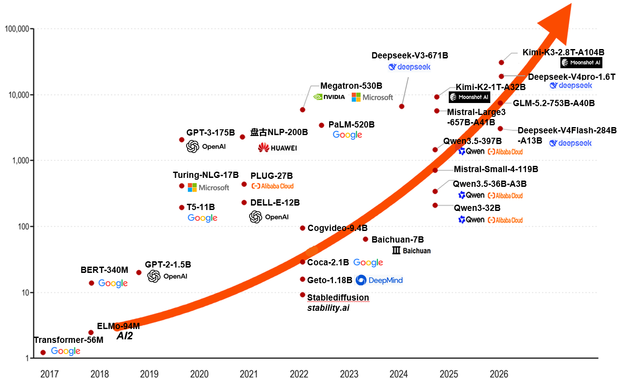
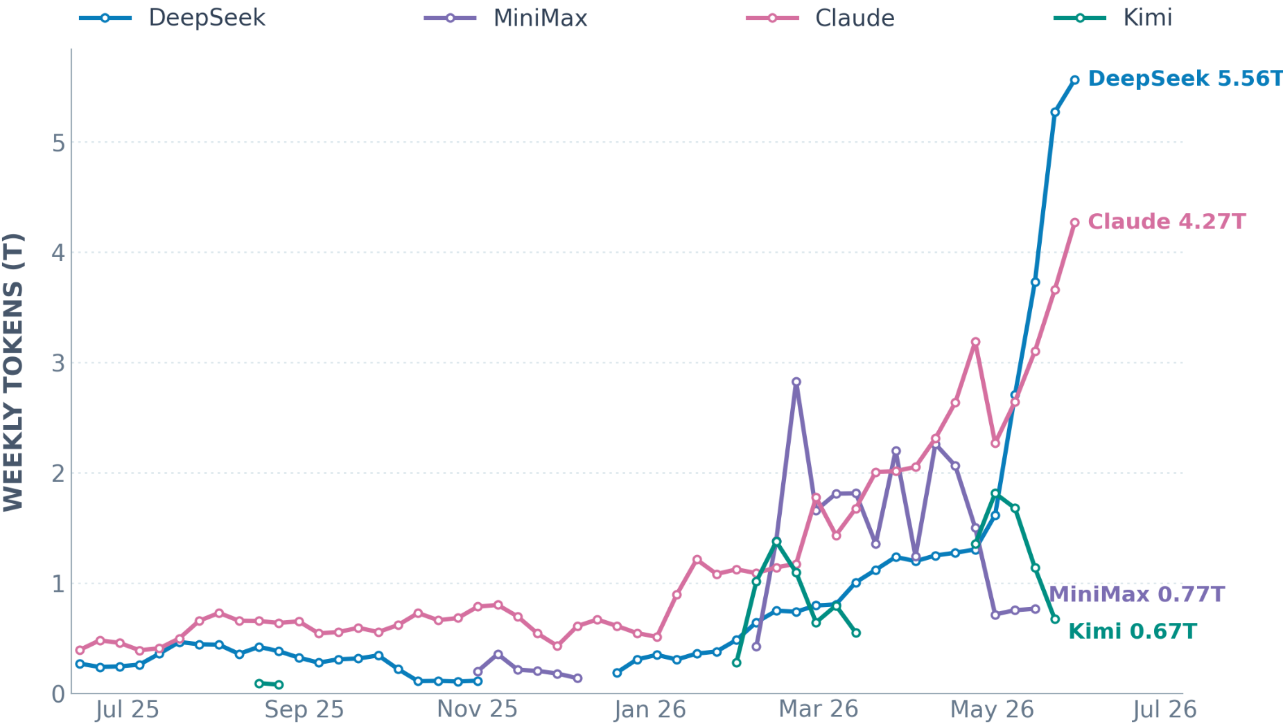
Explosive Growth in LLM Scale and Inference Demand
Frontier LLMs are scaling rapidly, with training compute doubling roughly every 5–6 months.
LLM inference token volume continues to rise rapidly, while leadership among major models shifts frequently.
Evolution of LLM Scale ^{[1]}
One Year of the LLM Usage Race from Openrouter ^{[2]}
[1] https://huggingface.co/models，Models – Hugging Face
[2] https://openrouter.ai/models?order=top-weekly， Models – Top Weekly | OpenRouterModels
2
Notes:
把左图重画替换掉。具体要求见下一页

Slide 3
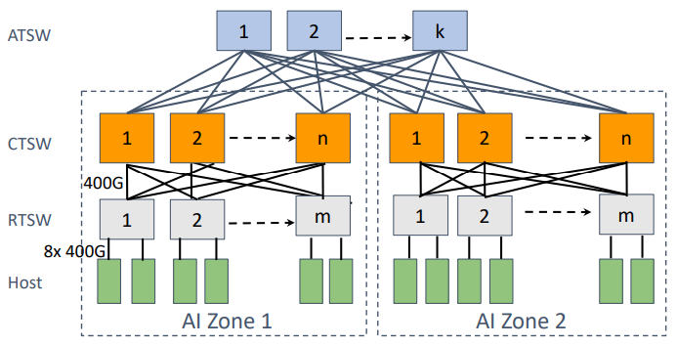
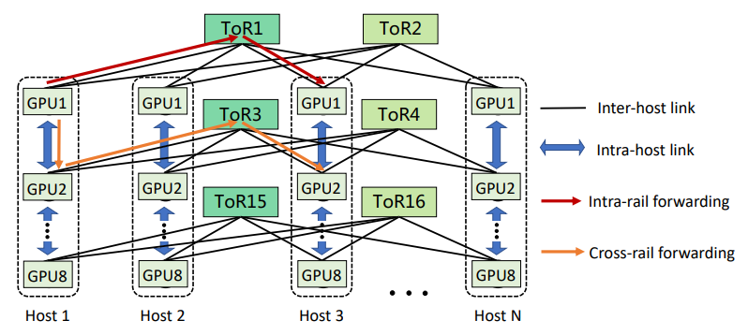
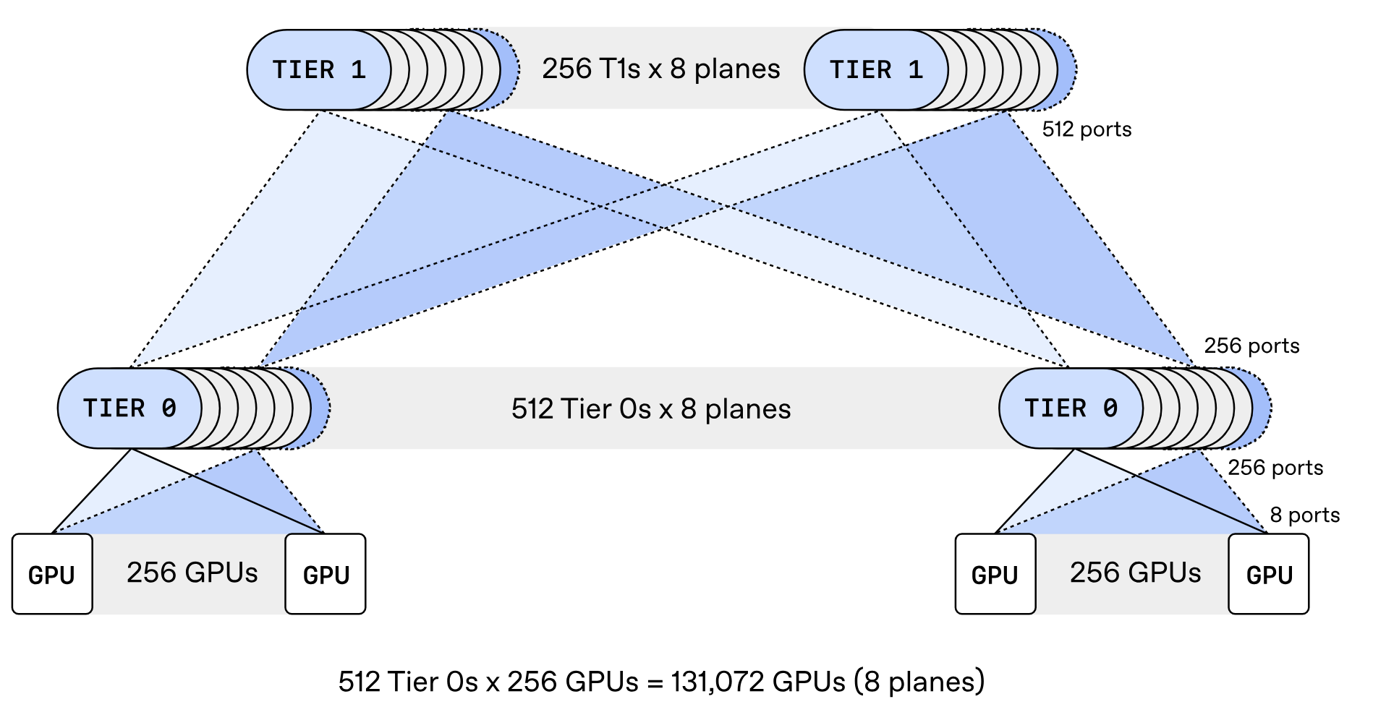
A Common Blueprint for Large-Scale AI Fabrics :
Multi-Tier, Multi-Plane, and Rail-Aware Connectivity
Meta, a three-level non-blocking topology
Alibaba, dual-plane multi-rail topology
OpenAI, multi-plane topology
[1] RDMA over Ethernet for Distributed AI Training at Meta Scale, SIGCOMM 2024
[2] Alibaba HPN: A Data Center Network for Large Language Model Training, SIGCOMM 2024
[3] https://openai.com/index/mrc-supercomputer-networking, 2026
3
Notes:
传统做法可能把一个 800Gb/s 网卡接口当作一个高速链路使用。MRC 的设计是把它拆成多个小链路，例如 8 个 100Gb/s 端口，连接到不同交换机，从而形成 8 个并行 network planes。这样可以用两层交换机连接约 131,000 个 GPU，而传统 800Gb/s 单平面网络可能需要三到四层交换机。相比传统三层或四层架构，这一设计显著降低了网络功耗与组件数量，在降低成本的同时提升了路径多样性。
自适应包喷洒技术
SRv6 源路由，微秒级绕过网络故障

Slide 4
Why New AI Fabrics? AI Workloads Are Reshaping Network Traffic
M2N
Training ：Hybrid Parallelism
Inference ：Disaggregated Serving
Take DeepSeek-V3 training as an example: PP, EP, and DP coexist
PD Separation + AF Separation
Stage 1
Stage 2
Stage 16
GPU
GPU
PP
comm
GPU
GPU
PP
comm
PP
comm
GPU
GPU
OSS/FS cluster
Replica 1
(DP copy 1)
…
decode node
GPU
GPU
GPU
GPU
GPU
GPU
prefill node
attention node
FFN/expert node
EP All-to-All
EP All-to-All
EP All-to-All
GPU
GPU
GPU
GPU
GPU
GPU
DP
sync
Q
PD Separation
AF Separation
KV Cache
M2N Traffic
Request
Reply
GPU
GPU
GPU
GPU
GPU
GPU
Stage 1
Stage 2
Stage 16
MoE EP Parallel Traffic
Replica 2
(DP copy 2)
GPU
GPU
PP
comm
GPU
GPU
PP
comm
PP
comm
GPU
GPU
…
Get KV Cache
(Prefix)
Transfer
KV Cache
GPU
GPU
GPU
GPU
GPU
GPU
⋮
EP All-to-All
EP All-to-All
EP All-to-All
Data Loading
KV Cache: stores intermediate state, avoids redundant computation, speeds up inference
PP Comm
EP Comm
DP Comm
$
Storage Layer
16-way PP, 64-way EP (across 8 nodes), 2-way DP
4
Notes:
Hybrid parallelism and disaggregated inference transform AI communication from generic any-to-any traffic into structured, synchronized, and topology-sensitive flows—driving multi-tier, multi-plane, and rail-aware fabrics.
左图：
把stage 3改成…，stage 4改成 Stage 16
把最小面一行的PP+EP…并行改成 16-way PP, 64-way EP（跨8节点），ZeRO-1 DP
把Stage 16和右边的箭头改成数据加载的
放了大概的参考图
右图：
把Attention节点与FFN/专家节点框起来，标上decode节点

Slide 5









Feature 1: AI Traffic Demands Both Low Latency and High
Bandwidth
EP All-to-All-V Example
1
Key Indicators of AI Traffic
Single-round comm task completion time
128 tokens
7168-dimensional vector
Expert Parallel (EP) All-to-All-V
$$T_{comm} = V / B_{eff} + T_{queue}$$
top-8 expert routing
Expert 0
Expert 1
BF16
merge
Communication completion time is jointly determined by data volume, effective bandwidth, and queuing delay.
Expert 2
Expert 3
2
Impact on performance
Communication volume per layer = 22 MB
•
Training: A higher $T_{comm}$lengthens synchronization and reduces training throughput.
Time budget
TPOT = 20 ms
61 layers
Per layer ≈ 327 us
Comm budget ≈ 163 us
•
Inference: A higher $T_{comm}$worsens TTFT and TPOT and increases the risk of SLA violations
Network Time
8 * 200 Gbps = 1.6 Tbps network
Ideal comm time = 110 us
3
Key Networking Technologies
Jitter Budget
Only 53 us jitter budget
•
Increase effective bandwidth
•
Reduce queuing delays
Even small bandwidth drops or queue build-ups exceed jitter budgets
5

Slide 6
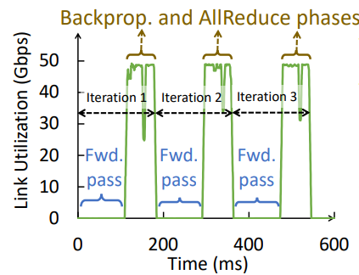
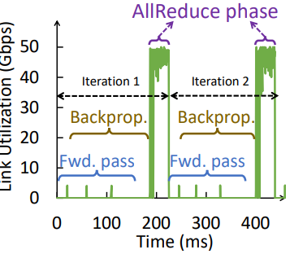
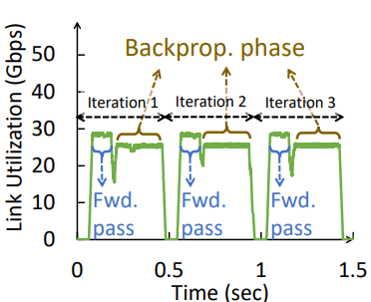
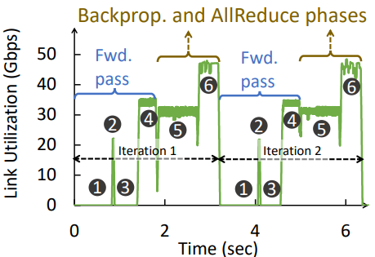
Feature 2: AI Training Generates Periodic and Sync Traffic Bursts
1. Traffic has multi-level periodicity
1
Data Parallelism (DP)
2
Pipeline Parallel (PP)
Iteration-level: Data parallelism triggers gradient synchronization at each iteration.
Microbatch-level: At the microbatch level, pipeline parallelism repeatedly transfers activations and gradients.
4
3
Tensor Parallelism (TP)
4
Hybrid Parallel (DP & PP & TP)
Layer-level: At the layer level, tensor parallelism repeatedly performs collective communication within each Transformer layer.
★
Overlapping cycles produce structured, predictable bursts in link utilization.
Periodic Link-Utilization Patterns Across Parallelism Strategies ^{[1]}
2. Opportunities and Challenges
Opportunity
Challenge
Communication tempo makes traffic more predictable
Semantic-aware scheduling and communications priority
Fine-grained irregular fluctuations
Short bursts can cause congestion
Resource allocation and bandwidth reservation
6
[1] CASSINI: Network-Aware Job Scheduling in Machine Learning Clusters, NSDI 2024
Notes:
Repeated compute–communication cycles synchronize thousands of GPUs, creating predictable yet intense traffic bursts.

Slide 7
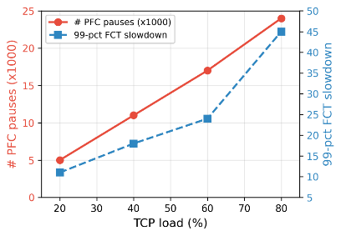
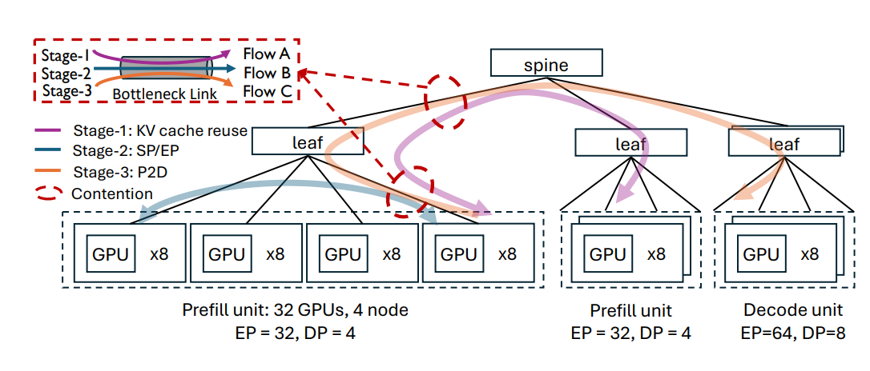
Feature 3: AI Fabrics Carry Heterogeneous Traffic with Conflicting Objectives
To avoid the cost of maintaining separate networks, the industry is converging AI and general-purpose traffic onto unified fabrics, as in ByteDance's Jakiro and Alibaba's Stella.
Challenges of Network Convergence：
(1) Competition for link resources between AI traffic and General-Purpose traffic
(2) Inference spans multiple communication stages whose traffic contends for shared links.
TCP flows coexist with RDMA flows
Link Contention Across Inference Stages
As AI traffic experiences more PFC pauses, flow completion time increases sharply.
Traffic from different inference requests overlaps in time and space, causing link congestion ^{[1]}
7
[1] Multi-stage Flow Scheduling for LLM Serving, arXiv 2026
Notes:
These characteristics demand high-capacity fabrics, burst-aware congestion control, and strong performance isolation.

Slide 8
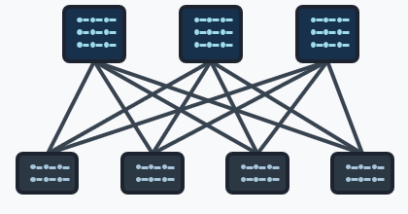


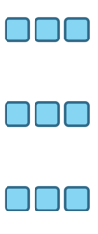
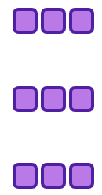
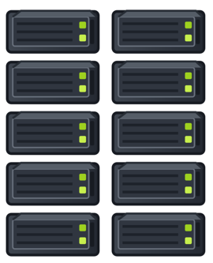



Overview of Our Recent Work in AI Cluster Networking
Spine layer
Switch's perspective
Source
Leaf layer
Destination
GPU Cluster
Traffic Generation
Ingress: isolation
Egress: schedule
Traffic Predict &
Engineering
Traffic Predict
Topology Reconfig
GPU Cluster
Traffic Engineer
GPU Cluster
Traffic Predict/
Engineering:
NetJIT [SIGMETRICS’25]
HalfLife (EuroSys’24]
Traffic Isolation:
InfiniFlow [SIGCOMM’26] /
Themis [NSDI'26]
BMW-Tree [SIGCOMM’23] /
vPIFO [SIGCOMM'24] /
Scale-up PIFO [SIGCOMM'26]
Schedule:
8
Notes:
在这张图中进行以下修改：
将数据产生->预测与拓扑重构->这一条路径上的“入口隔离” 修改成流量隔离；将交换机视角内的”入口：隔离/Buffer管理”修改成入口：隔离
在最下面一行中，将每个工作的名字后面增加发表信息：NetJIT[SIGMETRICS’25]，InfiniFlow[SIGCOMM’26在投] Themis[NSDI’26]，AIRP[ToN’26], 3D-INA[INFOCOM’26], BMW-Tree[SIGCOMM’23],vPIFO[SIGCOMM’24]

Slide 9
InfiniFlow:
Decoupling Virtual Channel Scalability from
Buffer Requirements in Lossless Datacenter Networks
SIGCOMM 2026

Slide 10
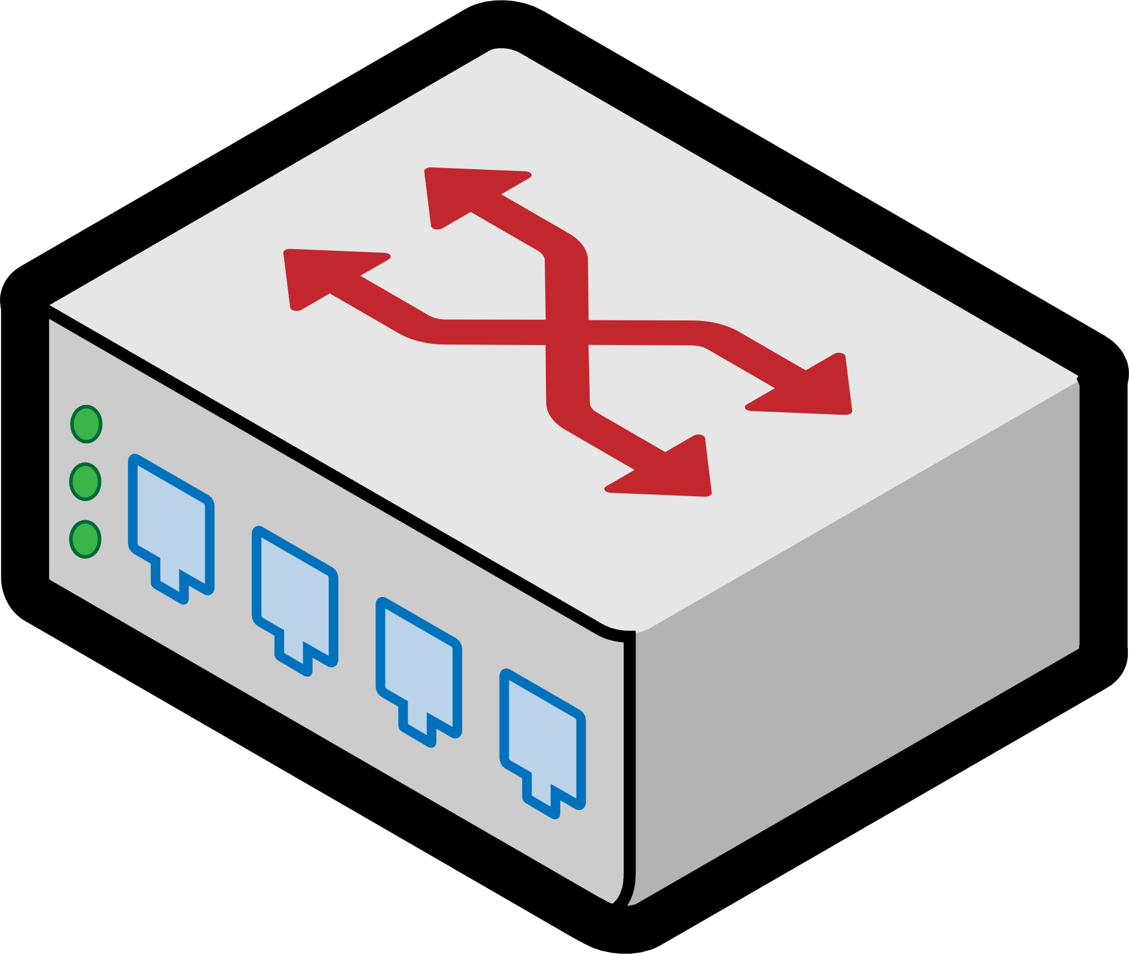
Virtual Channels in Lossless DCNs
DCNs rely on hop-by-hop flow control to achieve lossless transmission.
  PFC in Ethernet
  CBFC in InfiniBand
Flow control mechanisms independently operate on each Virtual Channel (VC).
upstream switch
downstream switch
VC Queues
VC Buffers
physical link
Q3
B3
Q2
B2
Q1
B1
Q0
B0
upstream port
downstream port
Notes:
数据中心网络依赖hop-by-hop的flow control来实现无损传输
Flow control是以Virtual Channel为粒度工作的

Slide 11
More VCs for Better Traffic Isolation
DCNs rely on hop-by-hop flow control to achieve lossless transmission.
  PFC in Ethernet
  CBFC in InfiniBand
Flow control mechanisms independently operate on each Virtual Channel (VC).
More VCs can enhance isolation between data flows, thus help to:
  mitigate Head-of-Line (HoL) blocking^{[1,2]}
  prevent PFC/CBFC deadlock^{[2,3]}
  enable finer-grained QoS scheduling^{[4]}
[1] Kexin Liu et al. “Pyrrha: Congestion-Root-Based Flow Control to Eliminate Head-of-Line Blocking in Datacenter”. In NSDI 2025
[2] Prateesh Goyal et al. “Backpressure Flow Control”. In NSDI 2022
[3] Weihao Jiang et al. “Orderlock: A New Type of Deadlock and its Implications on High Performance Network Protocol Design”. In SIGCOMM 2025
[4] M.R. Siavash Katebzadeh et al. “Saba: Rethinking Datacenter Network Allocation from Application’s Perspective”. In EuroSys 2023.
Notes:
更多的VC有利于缓解无损网络中普遍存在的HoL阻塞和死锁问题，还可以实现更细粒度的QoS调度

Slide 12
More VCs for Better Traffic Isolation
DCNs rely on hop-by-hop flow control to achieve lossless transmission.
  PFC in Ethernet
  CBFC in InfiniBand
Flow control mechanisms independently operate on each Virtual Channel (VC).
More VCs can enhance isolation between data flows, thus help to:
  mitigate Head-of-Line (HoL) blocking^{[1,2]}
  prevent PFC/CBFC deadlock^{[2,3]}
  enable finer-grained QoS scheduling^{[4]}
What is the barrier to supporting more VCs?
[1] Kexin Liu et al. “Pyrrha: Congestion-Root-Based Flow Control to Eliminate Head-of-Line Blocking in Datacenter”. In NSDI 2025
[2] Prateesh Goyal et al. “Backpressure Flow Control”. In NSDI 2022
[3] Weihao Jiang et al. “Orderlock: A New Type of Deadlock and its Implications on High Performance Network Protocol Design”. In SIGCOMM 2025
[4] M.R. Siavash Katebzadeh et al. “Saba: Rethinking Datacenter Network Allocation from Application’s Perspective”. In EuroSys 2023.
Notes:
既然增加VC数量这么有用，那么为什么大家现在不这么做呢？

Slide 13


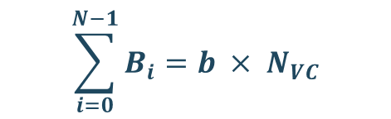


The Barrier to Supporting More VCs
Static allocation for lossless buffer
Lossless buffer quota for each VC
upstream switch
downstream switch
In CBFC, for each VC :
available buffer size
maximum achievable sending rate
$$R≤\frac{b}{τ}$$
VC Queues
physical link
VC Buffers
Q3
B3
per-hop RTT
Q2
B2
Q1
B1
$$R≥C$$
$$b≥C × τ=HBPD$$
Q0
B0
line-rate
per-hop BDP
upstream port
downstream port
Fixed quota for each VC
$$\sum_{i=0}^{N−1}{B_{i}}≥HBPD× N_{VC}$$
per-port buffer requirement
$$\sum_{i=0}^{N−1}{B_{i}}=b × N_{VC}$$
the number of VCs
Packet buffer space is the key barrier to supporting more VCs.
13
Notes:
答案在packet buffer space
目前主流的flow control方法，为每个VC分配一块静态的VC buffer（click），这就导致了每端口的buffer总需求随VC数量线性增长
同时（Click），每个VC的buffer配额还不能太小，因为，为了保证无损传输，每个VC的最大传输速率与其buffer配额成正比
对于CBFC来说，VC的最大传输速率要小于buffer配额除以per-hop RTT
(Click)为了保证VC能以线速传输
（Click）每个VC的buffer配额至少要保证一个per-hop BDP
（Click）因此，在静态buffer分配下，每个端口所需的最小buffer space会随着VC数量快速增长
（Click）因此packet buffer是增加VC的关键瓶颈
【到这里用时2分钟】

Slide 14
Inefficiency of Static Buffer Allocation
Case 1 in CBFC: VC_{j} is active alone.
per-VC buffer quota is 5 packets.
upstream egress port
downstream ingress port
VC_{i}
per-hop BDP
15 pkts
…
…
VC_{j}
Scheduler
Buffer Manager
…
…
VC_{k}
VC queues
VC buffers
Reserved Buffer for In-flight Packets
Occupied Buffer
Idle Buffer
14
Notes:
既然packet buffer如此precise，buffer有被充分利用好吗？
实际上，静态allocation下buffer的利用效率是很低的
我们看一个例子，在一段链路中，per-hop BDP假设是15 pkts，而由于总buffer不足而VC太多，（click）导致每个VC就分到了5 pkts的buffer space

Slide 15
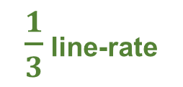
Inefficiency of Static Buffer Allocation
Case 1 in CBFC: VC_{j} is active alone.
per-VC buffer quota is 5 packets.
upstream egress port
downstream ingress port
wasted!
VC_{i}
per-hop BDP
15 pkts
…
…
VC_{j}
Scheduler
Buffer Manager
to egress port
…
…
VC_{k}
wasted!
$\frac{1}{3}$ line-rate
VC queues
VC buffers
Reserved Buffer for In-flight Packets
Occupied Buffer
Idle Buffer
15
Notes:
此时VC_j有流量到达，由于VC buffer太小，导致传输速率只有1/3线速（click）
想要提升速率需要更多的buffer，但是其他VC的buffer有不available to VC_j，(click)因此其他VC buffer就被wasted了

Slide 16
Inefficiency of Static Buffer Allocation
Case 1 in CBFC: VC_{j} is active alone.
upstream egress port
downstream ingress port
VC_{i}
per-hop BDP
15 pkts
…
VC_{j}
Scheduler
Buffer Manager
to egress port
…
VC_{k}
Shared buffer
$\frac{1}{3}$ line-rate
line-rate
VC queues
VC buffers
Reserved Buffer for In-flight Packets
Occupied Buffer
Idle Buffer
16
Notes:
如果我们能将所有VC buffer聚合成一个shared buffer pool，（click）那么VC_j就可以获得足够的buffer，进而实现线速传输了

Slide 17
Inefficiency of Static Buffer Allocation
Case 1 in CBFC: VC_{j} is active alone.
upstream egress port
downstream ingress port
per-hop BDP
15 pkts
How large the shared buffer should be?
VC_{i}
…
VC_{j}
Scheduler
Buffer Manager
to egress port
…
VC_{k}
Shared buffer
line-rate
VC queues
Reserved Buffer for In-flight Packets
Occupied Buffer
Idle Buffer
17
Notes:
如果我们能将所有VC buffer聚合成一个shared buffer pool，（click）那么VC_j就可以获得足够的buffer，进而实现线速传输了

Slide 18
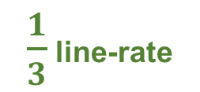
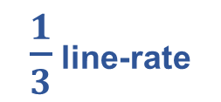
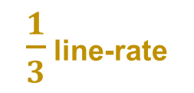
Inefficiency of Static Buffer Allocation
Case 2 in CBFC: Three VCs are concurrently active.
upstream egress port
downstream ingress port
$\frac{1}{3}$ line-rate
VC_{i}
per-hop BDP
15 pkts
to port 1
…
$\frac{1}{3}$ line-rate
VC_{j}
Scheduler
Buffer Manager
to port 2
…
VC_{k}
Shared buffer
$\frac{1}{3}$ line-rate
to port 3
line-rate
line-rate
VC queues
Reserved Buffer for In-flight Packets
Occupied Buffer
Idle Buffer
18
Notes:
那么，这个shared buffer应该是多大呢，我们看第二个例子，假设三个VC同时传输流量，但是由于下游拥塞，（click）导致传输速率都只有1/3线速。此时，其实每个VC都不需要分配一整个per-hop BDP的buffer，而是只需要1/3 per-hop BDP的buffer，就可以使得聚合速率到达线速。

Slide 19

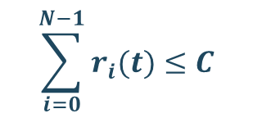
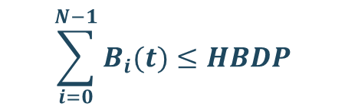
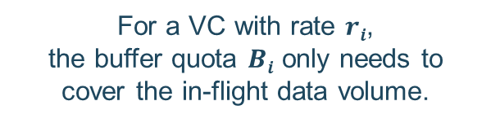

Inefficiency of Static Buffer Allocation
Case 2 in CBFC: Three VCs are concurrently active.
upstream egress port
downstream ingress port
$\frac{1}{3}$ line-rate
VC_{i}
per-hop BDP
15 pkts
to port 1
…
$\frac{1}{3}$ line-rate
VC_{j}
Scheduler
Buffer Manager
to port 2
…
VC_{k}
Shared buffer
$\frac{1}{3}$ line-rate
to port 3
line-rate
line-rate
VC queues
Key Insight
$$\sum_{i=0}^{N−1}{r_{i}(t)}≤C$$
$$\sum_{i=0}^{N−1}{B_{i}(t)}≤HBDP$$
$$B_{i}(t)=r_{i}(t)∙τ$$
For a VC with rate $ri$,
the buffer quota $Bi$ only needs to cover the in-flight data volume.
The aggregate VC rate is bounded by the physical bandwidth.
Theoretically, 1×per-hop-BDP of buffer space is sufficient.
19
Notes:
我们把这个结论泛化一下：（click）对于任意时刻，同端口所有VC的聚合速率受限于物理带宽。（click）如果我们可以给每个VC根据其传输速率分配恰到好处的buffer quota，那么理论上就可以把shared buffer具有1个per-hop BDP的空间大小就足以最大化链路利用率。

Slide 20
Design Goals of InfiniFlow
2
Maximizing Link Utilization
upstream egress port
downstream ingress port
VC_{i}
to port 1
…
VC_{j}
Scheduler
Buffer Manager
to port 2
…
VC_{k}
Shared buffer
to port 3
VC queues
1
Lossless transmission
3
Supporting more VCs with limited buffer capacity.
20
Notes:
基于这个key insight，我们提出了InfiniFlow。InfiniFlow的设计目标是，在保证无损传输（click）和链路带宽充分利用（click）的前提下，用limited buffer space支持大量的VC（click）
实现这三个目标的关键挑战的关键在于buffer在VC之间的划分
【到这里用时4分钟】

Slide 21
Design Challenge & Solution
21

Slide 22
Q1: Who Allocates the Buffer?
Traditional Local Allocation by Downstream Port
Buffer Manager
Buffer Manager
buffer allocation,
admission check
buffer allocation
VC_{N-1}
VC_{N-1}
…
Scheduler
…
Scheduler
VC₀
VC₀
upstream switch
downstream switch
separate from
The upstream scheduler knows how much buffer each VC needs.
The downstream manager decides how much buffer each VC gets.
2
1
22
Notes:
第一个问题是谁来分配buffer？通常，(click)交换机的buffer manager都是自己管理自己的buffer，（click）所以这种情况下，每一段链路的下游端口管理每个VC获得多少buffer。但是只有（click）上游端口才能知道每个VC需要多少。

Slide 23
Immediate Buffer Allocation in InfiniFlow
Solution: Upstream Allocates Buffer for Downstream (UABD)
1
Credit Pool
Credit pool serves as a proxy for the downstream shared buffer by tracking its overall availability.
Immediate allocation
Immediate allocation
buffer allocation for downstream VCs
VC_{N-1}
VC_{N-1}
…
Scheduler
…
Scheduler
VC₀
VC₀
upstream switch
downstream switch
2
Upstream-Driven Buffer Allocation
Scheduler not only allocates rates among VCs but also allocates buffer space based on the credit pool.
UABD in InfiniFlow enables immediate allocation for downstream buffer.
23
Notes:
基于这个思路，我们提出UABD buffer管理architecture。首先，（click）我们在上游建立了一个credit pool作为下游shared buffer的代理，credit pool反映了下游buffer的当前总体可用量。基于这个credit pool，(click)scheduler不仅负责了速率分配，也负责了buffer space的分配。具体来说就是，每当scheduler调度一个VC，发送一个数据包，scheduler就会从credit pool中扣除指定大小的credit，（click）因此，UABD可以在保证无损传输的同时，实现buffer space的immediate分配

Slide 24
Immediate Buffer Allocation in InfiniFlow
Case 3: Two VCs are concurrently active without downstream congestion.
upstream egress port
downstream ingress port
credit pool
16 pkts
per-hop BDP
16 pkts
VC_{i}
RR Scheduler
VC_{j}
Shared buffer
VC queues
Data Packets
Idle Buffer
Feedback Packets*
Reserved Buffer for In-flight Packets
Occupied Buffer
* The feedback packets in InfiniFlow paper are denoted as Buffer Control Packets (BCPs).
24
Notes:
我们用一个例子更直观理解一下：初始状态下链路没有数据传输，shared buffer是空的。假设per-hop BDP是16个pkts，而shared buffer大小也正好是16 pkts，所以credit的初始值也是16 pkts。此时（click）有两个VC同时激活

Slide 25
Immediate Buffer Allocation in InfiniFlow
Case 3: Two VCs are concurrently active without downstream congestion.
upstream egress port
downstream ingress port
credit pool
15 pkts
per-hop BDP
16 pkts
VC_{i}
RR Scheduler
VC_{j}
Shared buffer
VC queues
Data Packets
Idle Buffer
Feedback Packets*
Reserved Buffer for In-flight Packets
Occupied Buffer
* The feedback packets in InfiniFlow paper are denoted as Buffer Control Packets (BCPs).
25
Notes:
调度器发送了一个yellow pkt，并且从credit pool（click）中扣除了对应volume。注意，This action相当于在下游shared buffer（click）中预留了对应volume的space

Slide 26
Immediate Buffer Allocation in InfiniFlow
Case 3: Two VCs are concurrently active without downstream congestion.
upstream egress port
downstream ingress port
credit pool
14 pkts
per-hop BDP
16 pkts
VC_{i}
RR Scheduler
VC_{j}
Shared buffer
VC queues
Data Packets
Idle Buffer
Feedback Packets*
Reserved Buffer for In-flight Packets
Occupied Buffer
* The feedback packets in InfiniFlow paper are denoted as Buffer Control Packets (BCPs).
26
Notes:
同样的，当调度器发送一个蓝色数据包的时候，那么蓝色VC相当于立即获得了对应volume的buffer space

Slide 27
Immediate Buffer Allocation in InfiniFlow
Case 3: Two VCs are concurrently active without downstream congestion.
upstream egress port
downstream ingress port
credit pool
13 pkts
per-hop BDP
16 pkts
VC_{i}
RR Scheduler
VC_{j}
Shared buffer
VC queues
Data Packets
Idle Buffer
Feedback Packets*
Reserved Buffer for In-flight Packets
Occupied Buffer
* The feedback packets in InfiniFlow paper are denoted as Buffer Control Packets (BCPs).
27
Notes:
接下来，round robin调度器就交替调度两个VC

Slide 28
Immediate Buffer Allocation in InfiniFlow
Case 3: Two VCs are concurrently active without downstream congestion.
upstream egress port
downstream ingress port
credit pool
12 pkts
per-hop BDP
16 pkts
VC_{i}
RR Scheduler
VC_{j}
Shared buffer
VC queues
Data Packets
Idle Buffer
Feedback Packets*
Reserved Buffer for In-flight Packets
Occupied Buffer
* The feedback packets in InfiniFlow paper are denoted as Buffer Control Packets (BCPs).
28
Notes:
接下来，round robin调度器就交替调度两个VC

Slide 29
Immediate Buffer Allocation in InfiniFlow
Case 3: Two VCs are concurrently active without downstream congestion.
upstream egress port
downstream ingress port
credit pool
11 pkts
per-hop BDP
16 pkts
VC_{i}
RR Scheduler
VC_{j}
Shared buffer
VC queues
Data Packets
Idle Buffer
Feedback Packets*
Reserved Buffer for In-flight Packets
Occupied Buffer
* The feedback packets in InfiniFlow paper are denoted as Buffer Control Packets (BCPs).
29
Notes:
接下来，round robin调度器就交替调度两个VC

Slide 30
Immediate Buffer Allocation in InfiniFlow
Case 3: Two VCs are concurrently active without downstream congestion.
upstream egress port
downstream ingress port
credit pool
10 pkts
per-hop BDP
16 pkts
VC_{i}
RR Scheduler
VC_{j}
Shared buffer
VC queues
Data Packets
Idle Buffer
Feedback Packets*
Reserved Buffer for In-flight Packets
Occupied Buffer
* The feedback packets in InfiniFlow paper are denoted as Buffer Control Packets (BCPs).
30
Notes:
接下来，round robin调度器就交替调度两个VC

Slide 31
Immediate Buffer Allocation in InfiniFlow
Case 3: Two VCs are concurrently active without downstream congestion.
upstream egress port
downstream ingress port
credit pool
9 pkts
per-hop BDP
16 pkts
VC_{i}
RR Scheduler
VC_{j}
Shared buffer
VC queues
Data Packets
Idle Buffer
Feedback Packets*
Reserved Buffer for In-flight Packets
Occupied Buffer
* The feedback packets in InfiniFlow paper are denoted as Buffer Control Packets (BCPs).
31
Notes:
接下来，round robin调度器就交替调度两个VC

Slide 32
Immediate Buffer Allocation in InfiniFlow
Case 3: Two VCs are concurrently active without downstream congestion.
upstream egress port
downstream ingress port
credit pool
8 pkts
per-hop BDP
16 pkts
VC_{i}
RR Scheduler
VC_{j}
Shared buffer
VC queues
Data Packets
Idle Buffer
Feedback Packets*
Reserved Buffer for In-flight Packets
Occupied Buffer
* The feedback packets in InfiniFlow paper are denoted as Buffer Control Packets (BCPs).
32
Notes:
接下来，round robin调度器就交替调度两个VC

Slide 33
Immediate Buffer Allocation in InfiniFlow
Case 3: Two VCs are concurrently active without downstream congestion.
upstream egress port
downstream ingress port
credit pool
7 pkts
per-hop BDP
16 pkts
VC_{i}
to port 1
RR Scheduler
VC_{j}
Shared buffer
VC queues
Data Packets
Idle Buffer
Feedback Packets*
Reserved Buffer for In-flight Packets
Occupied Buffer
* The feedback packets in InfiniFlow paper are denoted as Buffer Control Packets (BCPs).
33
Notes:
接下来，round robin调度器就交替调度两个VC

Slide 34
Immediate Buffer Allocation in InfiniFlow
Case 3: Two VCs are concurrently active without downstream congestion.
upstream egress port
downstream ingress port
credit pool
6 pkts
per-hop BDP
16 pkts
VC_{i}
RR Scheduler
VC_{j}
Shared buffer
to port 2
VC queues
Data Packets
Idle Buffer
Feedback Packets*
Reserved Buffer for In-flight Packets
Occupied Buffer
* The feedback packets in InfiniFlow paper are denoted as Buffer Control Packets (BCPs).
34
Notes:
接下来，round robin调度器就交替调度两个VC

Slide 35
Immediate Buffer Allocation in InfiniFlow
Case 3: Two VCs are concurrently active without downstream congestion.
upstream egress port
downstream ingress port
credit pool
5 pkts
per-hop BDP
16 pkts
VC_{i}
to port 1
RR Scheduler
VC_{j}
Shared buffer
VC queues
Data Packets
Idle Buffer
Feedback Packets*
Reserved Buffer for In-flight Packets
Occupied Buffer
* The feedback packets in InfiniFlow paper are denoted as Buffer Control Packets (BCPs).
35
Notes:
接下来，round robin调度器就交替调度两个VC

Slide 36
Immediate Buffer Allocation in InfiniFlow
Case 3: Two VCs are concurrently active without downstream congestion.
upstream egress port
downstream ingress port
credit pool
4 pkts
per-hop BDP
16 pkts
VC_{i}
RR Scheduler
VC_{j}
Shared buffer
to port 2
VC queues
Data Packets
Idle Buffer
Feedback Packets*
Reserved Buffer for In-flight Packets
Occupied Buffer
* The feedback packets in InfiniFlow paper are denoted as Buffer Control Packets (BCPs).
36
Notes:
接下来，round robin调度器就交替调度两个VC

Slide 37
Immediate Buffer Allocation in InfiniFlow
Case 3: Two VCs are concurrently active without downstream congestion.
upstream egress port
downstream ingress port
credit pool
3 pkts
per-hop BDP
16 pkts
VC_{i}
to port 1
RR Scheduler
VC_{j}
Shared buffer
VC queues
Data Packets
Idle Buffer
Feedback Packets*
Reserved Buffer for In-flight Packets
Occupied Buffer
* The feedback packets in InfiniFlow paper are denoted as Buffer Control Packets (BCPs).
37
Notes:
接下来，round robin调度器就交替调度两个VC

Slide 38
Immediate Buffer Allocation in InfiniFlow
Case 3: Two VCs are concurrently active without downstream congestion.
upstream egress port
downstream ingress port
credit pool
2 pkts
per-hop BDP
16 pkts
VC_{i}
RR Scheduler
VC_{j}
Shared buffer
to port 2
VC queues
Data Packets
Idle Buffer
Feedback Packets*
Reserved Buffer for In-flight Packets
Occupied Buffer
* The feedback packets in InfiniFlow paper are denoted as Buffer Control Packets (BCPs).
38
Notes:
接下来，round robin调度器就交替调度两个VC

Slide 39
Immediate Buffer Allocation in InfiniFlow
Case 3: Two VCs are concurrently active without downstream congestion.
upstream egress port
downstream ingress port
credit pool
1 pkt
per-hop BDP
16 pkts
VC_{i}
to port 1
RR Scheduler
VC_{j}
Shared buffer
VC queues
Data Packets
Idle Buffer
Feedback Packets*
Reserved Buffer for In-flight Packets
Occupied Buffer
* The feedback packets in InfiniFlow paper are denoted as Buffer Control Packets (BCPs).
39
Notes:
接下来，round robin调度器就交替调度两个VC

Slide 40
Immediate Buffer Allocation in InfiniFlow
Case 3: Two VCs are concurrently active without downstream congestion.
upstream egress port
downstream ingress port
credit pool
0 pkt
per-hop BDP
16 pkts
VC_{i}
RR Scheduler
VC_{j}
Shared buffer
to port 2
VC queues
Data Packets
Idle Buffer
Feedback Packets*
Reserved Buffer for In-flight Packets
Occupied Buffer
* The feedback packets in InfiniFlow paper are denoted as Buffer Control Packets (BCPs).
40
Notes:
接下来，round robin调度器就交替调度两个VC

Slide 41
Immediate Buffer Allocation in InfiniFlow
Case 3: Two VCs are concurrently active without downstream congestion.
upstream egress port
downstream ingress port
credit pool
0 pkt
per-hop BDP
16 pkts
VC_{i}
to port 1
RR Scheduler
VC_{j}
Shared buffer
VC queues
Data Packets
Idle Buffer
Feedback Packets*
Reserved Buffer for In-flight Packets
Occupied Buffer
* The feedback packets in InfiniFlow paper are denoted as Buffer Control Packets (BCPs).
41
Notes:
接下来，round robin调度器就交替调度两个VC

Slide 42
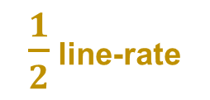
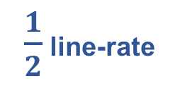
Immediate Buffer Allocation in InfiniFlow
Case 3: Two VCs are concurrently active without downstream congestion.
upstream egress port
downstream ingress port
credit pool
0 pkt
$\frac{1}{2}$ line-rate
VC_{i}
to port 1
RR Scheduler
VC_{j}
Shared buffer
to port 2
VC queues
$\frac{1}{2}$ line-rate
Data Packets
Idle Buffer
Feedback Packets*
Reserved Buffer for In-flight Packets
Occupied Buffer
* The feedback packets in InfiniFlow paper are denoted as Buffer Control Packets (BCPs).
42
Notes:
最终，把scheduler把buffer space 和 链路带宽均分给了两个VC

Slide 43
Immediate Buffer Allocation in InfiniFlow
Case 3: Two VCs are concurrently active without downstream congestion.
upstream egress port
downstream ingress port
credit pool
0 pkt
$\frac{1}{2}$ line-rate
Does UABD solve all the problems?
VC_{i}
to port 1
RR Scheduler
VC_{j}
Shared buffer
to port 2
VC queues
$\frac{1}{2}$ line-rate
Data Packets
Idle Buffer
Feedback Packets*
Reserved Buffer for In-flight Packets
Occupied Buffer
* The feedback packets in InfiniFlow paper are denoted as Buffer Control Packets (BCPs).
43
Notes:
最终，把scheduler把buffer space 和 链路带宽均分给了两个VC

Slide 44
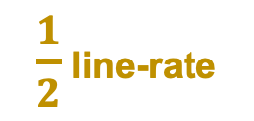
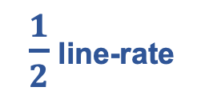
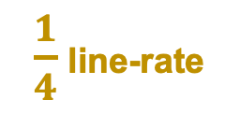
Q2: How to Allocate Buffer?
with
Case 4: Two VCs are concurrently active without downstream congestion.
upstream egress port
downstream ingress port
credit pool
0 pkt
$\frac{1}{2}$ line-rate
downstream congestion
queue ↑
$\frac{1}{4}$ line-rate
VC_{i}
to port 1
RR Scheduler
VC_{j}
Shared buffer
to port 2
VC queues
No downstream congestion
$\frac{1}{2}$ line-rate
Data Packets
Idle Buffer
Feedback Packets*
Reserved Buffer for In-flight Packets
Occupied Buffer
* The feedback packets in InfiniFlow paper are denoted as Buffer Control Packets (BCPs).
44
Notes:
我们先看一下，如果不对每个VC的使用量进行限制，会发生什么问题。继续刚才的例子，假设黄色data flow的下游发生了拥塞，（click）导致排出速率只有1/4线速.由于输入速率大于排出速率，所以（click）buffer中开始堆积yellow pkts。

Slide 45
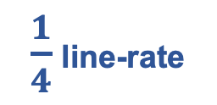
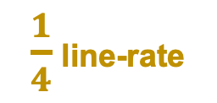
Q2: How to Allocate Buffer?
with
Case 4: Two VCs are concurrently active without downstream congestion.
upstream egress port
locked
downstream ingress port
credit pool
0 pkt
$\frac{1}{4}$ line-rate
downstream congestion
steady state
standing queue
$\frac{1}{4}$ line-rate
VC_{i}
to port 1
RR Scheduler
VC_{j}
Shared buffer
to port 2
VC queues
No downstream congestion
$\frac{1}{4}$ line-rate
Data Packets
Reserved Buffer for In-flight Packets
Feedback Packets*
Occupied Buffer
Idle Buffer
* The feedback packets in InfiniFlow paper are denoted as Buffer Control Packets (BCPs).
45
Notes:
在稳态下，将呈现这样的状态，黄色流的传输速率和排出速率相等，同时将大量credit锁在了buffer里。而蓝色流虽然下游没有拥塞，但是由于RR调度策略，蓝色流的传输速率也被锁死在了1/4线速（click），造成了链路利用率不足

Slide 46
Q2: How to Allocate Buffer?
with
Case 4: Two VCs are concurrently active without downstream congestion.
upstream egress port
locked
downstream ingress port
credit pool
0 pkt
$\frac{1}{4}$ line-rate
downstream congestion
steady state
standing queue
$\frac{1}{4}$ line-rate
VC_{i}
to port 1
RR Scheduler
VC_{j}
Shared buffer
to port 2
VC queues
No downstream congestion
$\frac{1}{4}$ line-rate
Per-VC credit consumption must be constrained according to per-VC backlog states.
46
Notes:
因此，仅仅根据调度策略给VC分配buffer是不够的，buffer allocation必须结合per-VC的backlog states

Slide 47
Buffer Usage Control in InfiniFlow
Solution: Buffer Usage Control Protocol (BUCP)
Per-VC states in BUCP:
  In-flight Bytes: per-VC credit consumption
  Threshold: per-VC threshold that limits credit consumption
  Backlog: per-VC backlogged data volume in the downstream buffer
large backlog → over-credited
no backlog → under-credited
tighten the threshold, reduce credit consumption.
relax the threshold, increase credit consumption.
Data Packets
Data Packets
VC Queue
Feedback
Buffer
VC Queue
Feedback
Buffer
upstream port
downstream port
upstream port
downstream port
if (vc_backlog >= qmax):
threshold =
inflight_bytes – (vc_backlog – qmin)
if (vc_backlog < qmin):
threshold =
threshold + (qmin - vc_backlog)
BUCP aims to maintain the per-VC backlog at an extremely low but non-zero level.
47
Notes:
为了最大化链路利用率，我们提出了Buffer Usage Control Protocol。BUCP为每个VC维护了三个变量，（click）inflight bytes用来追踪每个VC的credit使用量，（click）threshold用来限制每个VC的inflight bytes，（click）backlog用来记录每个VC在downstream buffer里的backlog volume，并且每个VC的backlog会随着其feedback packets返回给上游调度器。
上游调度器如果发现VC的backlog太大，超过了静态阈值qmax，那么就会收紧threshold，来减少这个VC的credit consumption，进而避免过长的standing queue。
但是对于每个VC来说，standing queue也不是越小越好。过短的standing queue会导致，拥塞突然消失时出现链路利用率不足。
（click）因此，我们将每个VC的目标standing queue长度作为一个静态配置的非零参数qmin。当backlog小于qmin的时候，BUCP会放宽threshold，让这个VC可以使用更多的credit。
更多的detail请看论文
【这里10分钟讲完】

Slide 48
Features of InfiniFlow
Feature 1: Lossless Transmission
Feature 2: Decoupling Buffer Requirement with the Number of VCs
  Theoretically, a single per-hop BDP for each port.
  In practice, 3× per-hop BDP buffer per port is recommended.
Feature 3: Integrating Buffer and Rate Allocation
  RR scheduling → max-min fair rate allocation.
  Compatible with more scheduling policies
    WRR
    SP, SRTP^{[1]}
    hierarchical scheduling^{[2]}.
Feature 4: Rate control without end-to-end CC
  Sufficient VCs → per-flow flow control^{[3]}
[1] Behnam Montazeri et al. “Homa: a receiver-driven low-latency transport protocol using network priorities”. In SIGCOMM 2018
[2] Zhiyu Zhang et al. “vPIFO: Virtualized Packet Scheduler for Programmable Hierarchical Scheduling in High-Speed Networks”. In SIGCOMM 2024
[3] Prateesh Goyal et al. “Backpressure Flow Control”. In NSDI 2022
48
Notes:
【这里11分钟讲完】

Slide 49
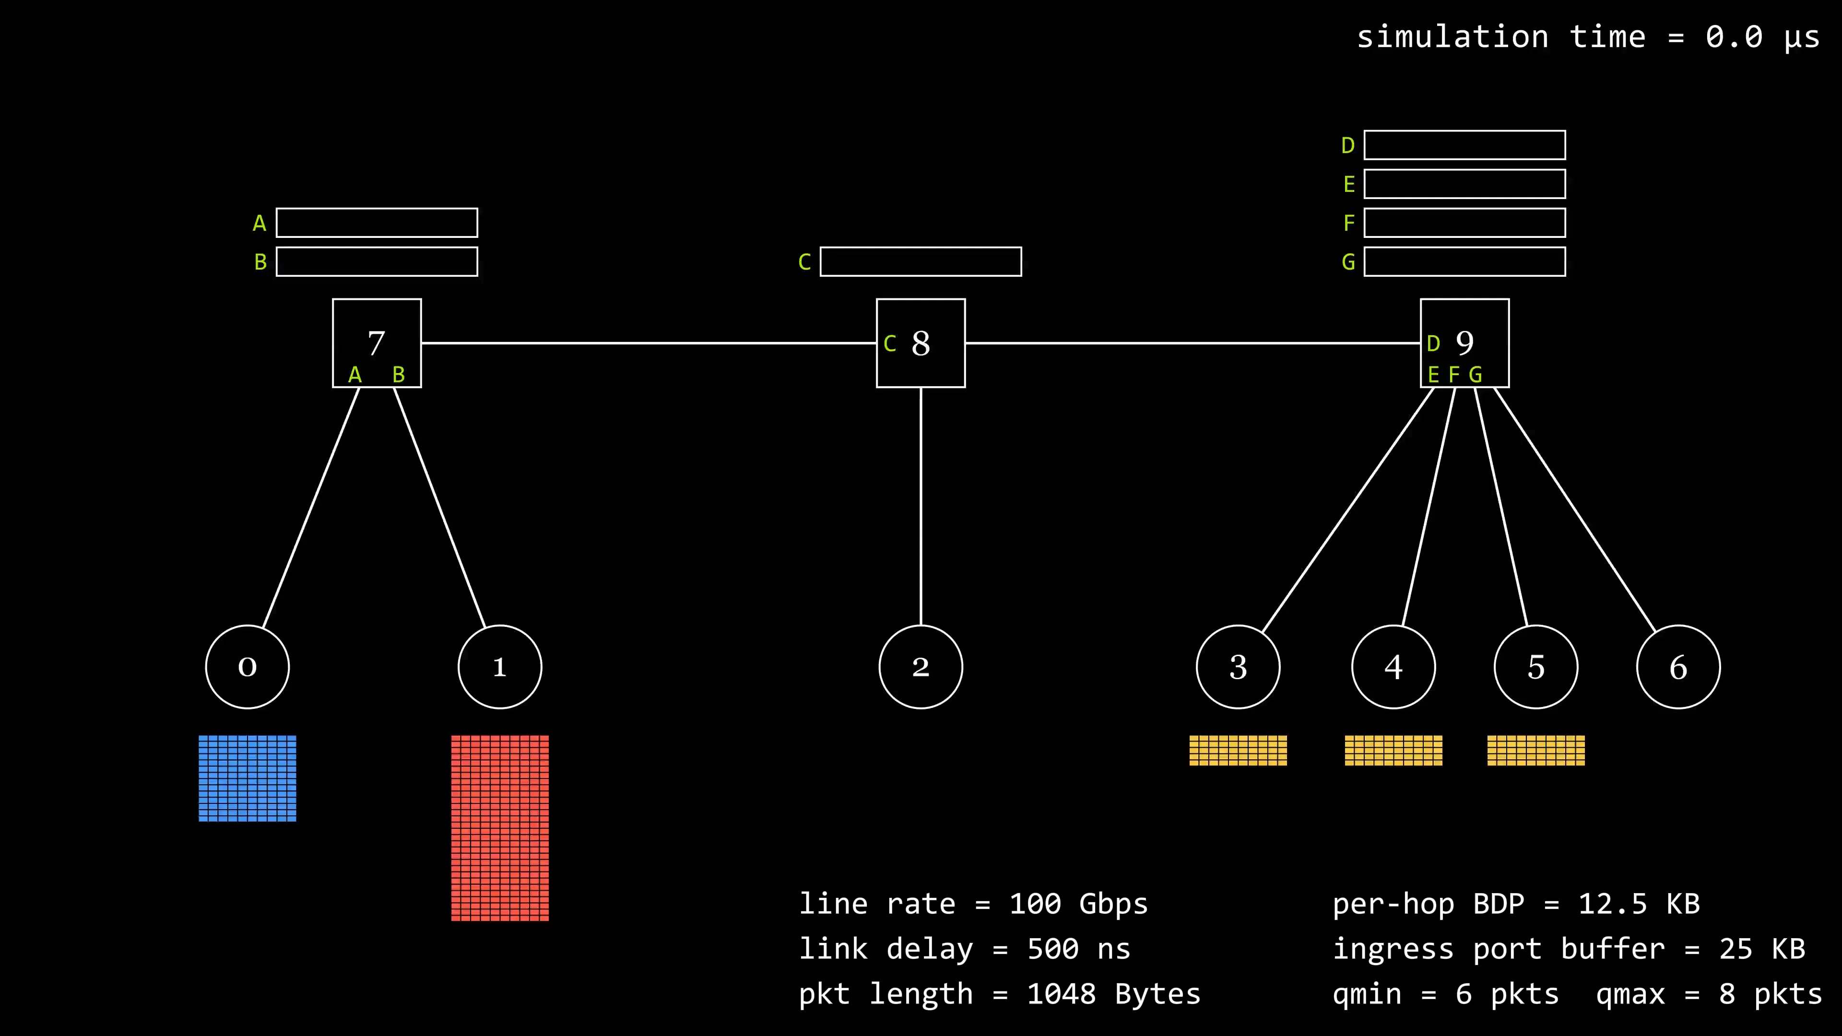
InfiniFlow in Action
Notes:
预留2分钟（1.1倍速播放）

Slide 50
Evaluations
50
Notes:
第12分钟，剩下3分钟

Slide 51
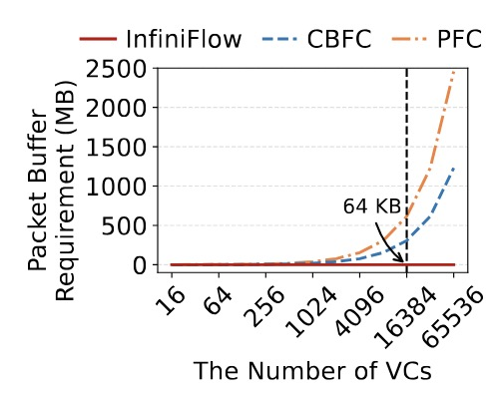
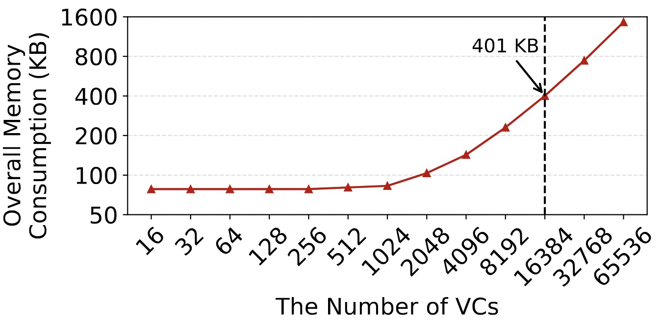
VC Scalability Evaluation
  With fewer VCs, fixed overhead dominates.
  With more VCs,
  VC state overhead dominates.
Platform: U280 FPGA Accelerator Card
64 ports → 25.7 MB
  Per-port Packet Buffer Requirement
  Per-port On-Chip Memory Requirement
  Including the packet buffer, VC state bank, and other components
  InfiniFlow supports over 16K VCs with only 401 KB of on-chip memory per port.
51

Slide 52
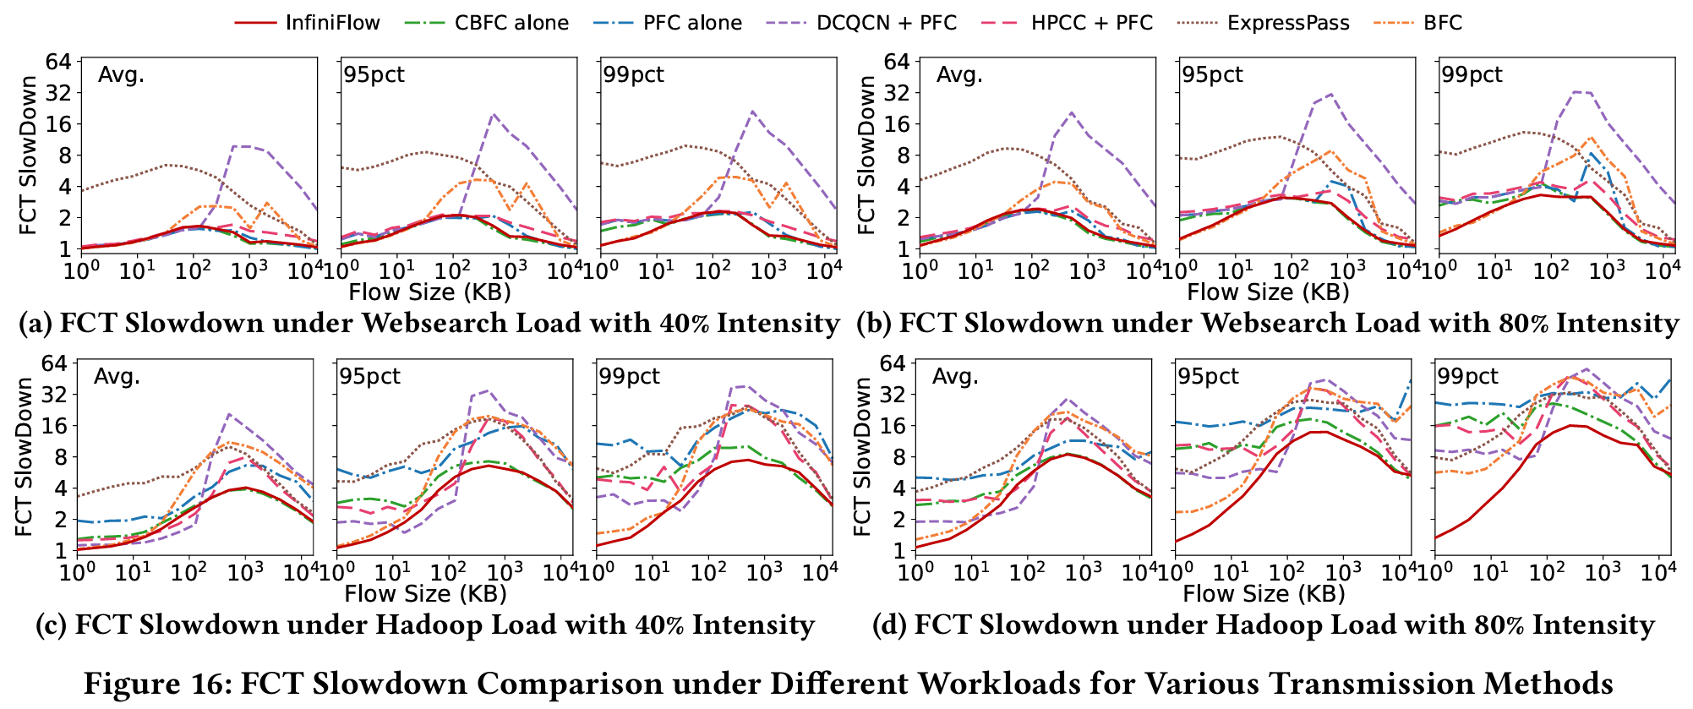
Large-Scale NS-3 Simulations
Topology: Leaf-Spine Network with 1,024 hosts
  InfiniFlow excels in average and tail FCT without relying on end-to-end rate control.
52

Slide 53
Large-Scale NS-3 Simulations
Topology: Leaf-Spine Network with 1,024 hosts
With enough VCs, per-flow flow control becomes possible.
Is end-to-end CC still needed for rate control?
  InfiniFlow excels in average and tail FCT without relying on end-to-end rate control.
53

Slide 54
Themis
Scheduling-Aware Buffer Management for HBM-Based Hybrid Buffers
NSDI 2026
54

Slide 55
HBM-Based Hybrid Buffers
• HBM serves as overflow buffer for packets spilled from SRAM.
• SRAM and HBM work together to achieve both high speed and large capacity.
On-Chip SRAM
Arriving
Packets
Buffer
Management
DepartingPackets
Off-Chip HBM
55

Slide 56

Existing Hybrid Buffer Designs: Poor HBM Access Patterns Reduce Effective Bandwidth
HBM accesses must satisfy two conditions to reach full rated bandwidth:
Spatial Locality: Contiguous Addresses
Temporal Locality: Continuous Same-Type Operations
✓ Even data distribution across PCs and BGs → Maximum parallelism
✓ Full-row read per activation → Amortized tACT/tPRE latency
✓ Use batches of consecutive reads or writes
✓ Avoid read/write interleaving to reduce bus turnaround overhead
However, packet-buffer access patterns inherently lack continuity
Packet arrival order ≠ Departure order
Read-write interleaving is inevitable
Because the scheduler determines the packet readout order, continuity of write addresses and read addresses cannot be achieved simultaneously.✗
Packet-arrival events are unpredictable (writes), while dequeue events continue (reads), so operation continuity cannot be guaranteed.✗
Under existing designs, measured HBM bandwidth can fall to just one-ninth of the peak bandwidth.
56

Slide 57
Existing Hybrid Buffer Scheme – Priority Inversion
Treat HBM as pure spillover space - simple but inefficient
Buffer management (length and threshold only)
Scheduler (based on scheduling priority)
On-Chip SRAM
On-Chip SRAM
Scheduling Priority
6
5
4
3
2
1
>
=
3
2
1
3
2
1
4
3
2
1
The part that exceeds threshold spills into the off-chip HBM
When on-chip high-priority flows are exhausted, the scheduler must fetch packets from off-chip memory
4
3
2
1
11
6
Threshold
10
Next to depart
9
8
7
11
10
9
8
7
Off-Chip HBM
Off-Chip HBM
Traditional designs leave high-speed SRAM idle and repeatedly read and write slow HBM, failing to deliver the promised combination of speed and capacity.
57

Slide 58
Themis: Scheduling-Aware Admission Control
Make the Buffer Manager (BM) rank-aware so that it follows the scheduler's ordering.
The next packet to depart is always kept in SRAM.
>
=
Scheduling Priority
X
X: Arrival order
X
-----
Y
X: Arrival order
Y: Departure order, determined by the scheduler
18
17
16
15
14
13
12
6
5
3
1
16
-----
[9]
13
-----
[6]
10
-----
[106]
7
-----
[103]
4
-----
[102]
1
-----
[1]
8
7
2
17
-----
[10]
14
-----
[7]
11
-----
[108]
8
-----
[105]
5
-----
[3]
2
-----
[101]
11
10
9
4
12
-----
[5]
9
-----
[104]
6
-----
[4]
3
-----
[2]
On-Chip SRAM
On-Chip SRAM
Traditional per-flow queue
Limit individual queue lengths
Themis Shared Buffer
No queue abstraction required
58

Slide 59
Themis: Batched HBM Access
Actively reorganize each HBM access using contiguous addresses and a single operation type
When SRAM is nearly full, proactively spill a batch to HBM.
Reverse the packet selection logic of the scheduler.
Swap out the packet with the largest rank.
22
-----
[12]
16
-----
[9]
13
-----
[6]
10
-----
[106]
7
-----
[103]
4
-----
[102]
1
-----
[1]
Scheduling Priority
17
-----
[10]
14
-----
[7]
11
-----
[108]
8
-----
[105]
5
-----
[3]
2
-----
[101]
>
=
18
-----
[11]
15
-----
[8]
12
-----
[5]
9
-----
[104]
6
-----
[4]
3
-----
[2]
Arriving
Packets
DepartingPackets
8
-----
[105]
23
-----
[116]
19
-----
[110]
10
-----
[106]
24
-----
[118]
20
-----
[112]
11
-----
[108]
25
-----
[120]
21
-----
[114]
Batch Write
• Spatial dimension: Packets with close ranks are grouped into batches and written to contiguous addresses.
• Time dimension: Packets are written to HBM in full batches; packets are prefetched from HBM in full batches.
59

Slide 60
Themis: Batched HBM Access
Actively reorganize each HBM access using contiguous addresses and a single operation type
When SRAM is nearly empty, proactively prefetch a batch from HBM.
Reuse scheduler packet selection logic
Swap in the packet with the smallest rank.
22
-----
[12]
26
-----
[13]
Scheduling Priority
27
-----
[14]
>
=
18
-----
[11]
2
-----
[101]
Arriving
Packets
DepartingPackets
26
-----
[13]
4
-----
[102]
8
-----
[105]
23
-----
[116]
19
-----
[110]
27
-----
[14]
7
-----
[103]
10
-----
[106]
24
-----
[118]
20
-----
[112]
2
-----
[101]
9
-----
[104]
11
-----
[108]
25
-----
[120]
21
-----
[114]
Batch Read
• Spatial dimension: Packets with close ranks are grouped into batches and written to contiguous addresses.
• Time dimension: Packets are written to HBM in full batches; packets are prefetched from HBM in full batches.
60

Slide 61
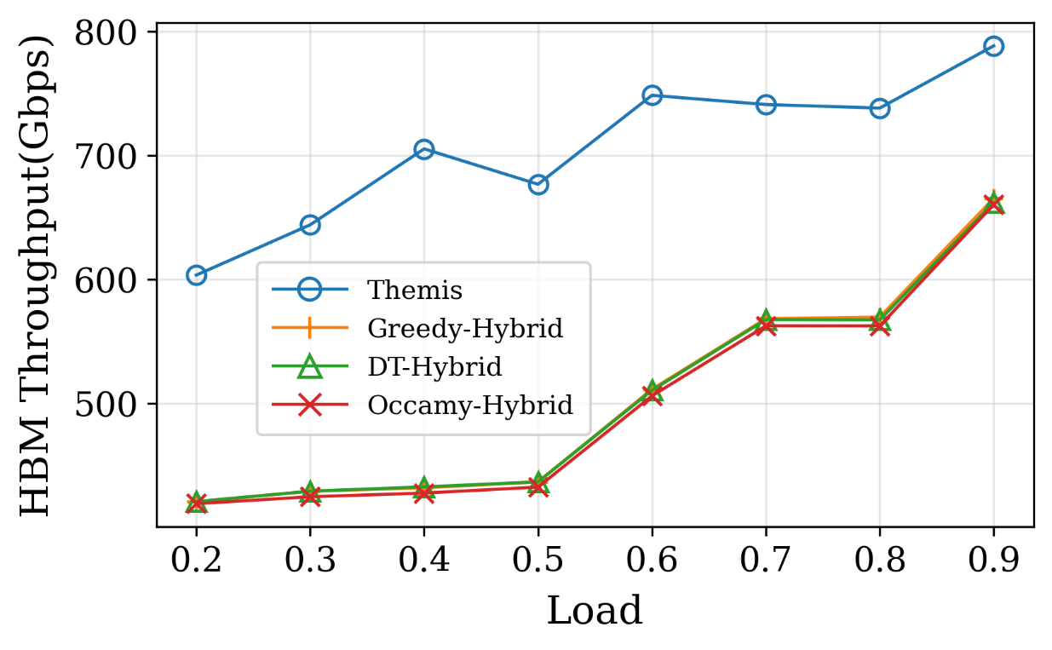
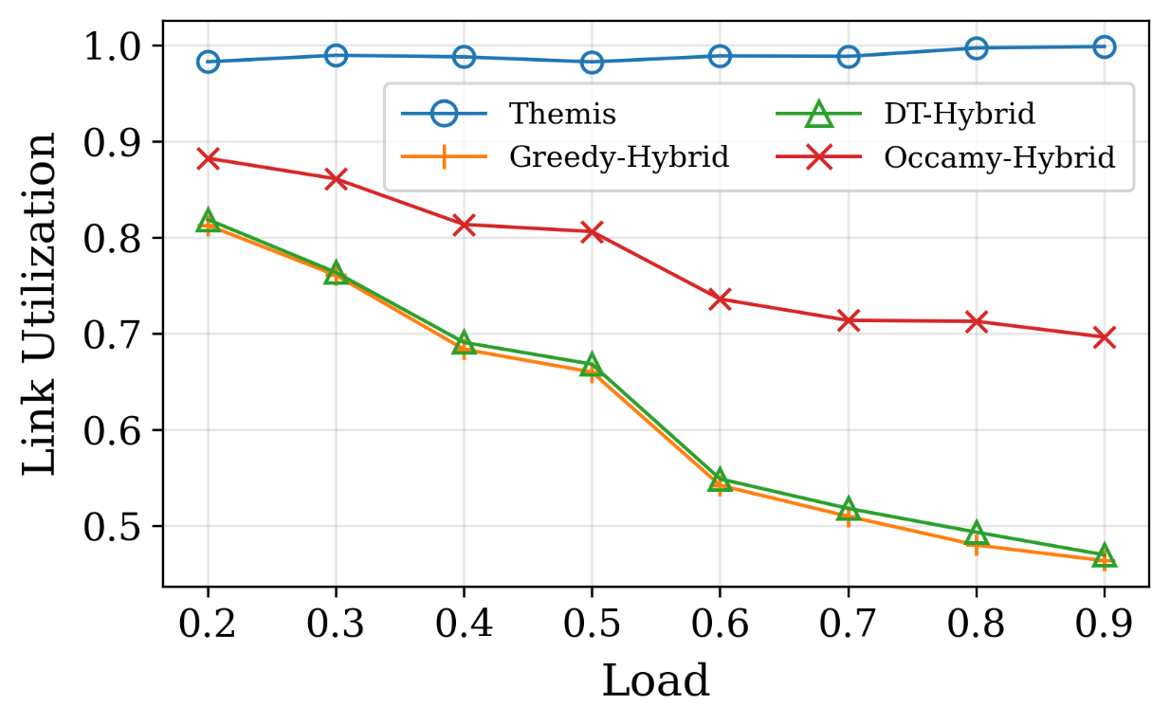
Performance of Themis
HBM Throughput
Link Utilization
Contiguous addresses + batched access unlock effective HBM bandwidth, maximizing egress link utilization
61

Slide 62
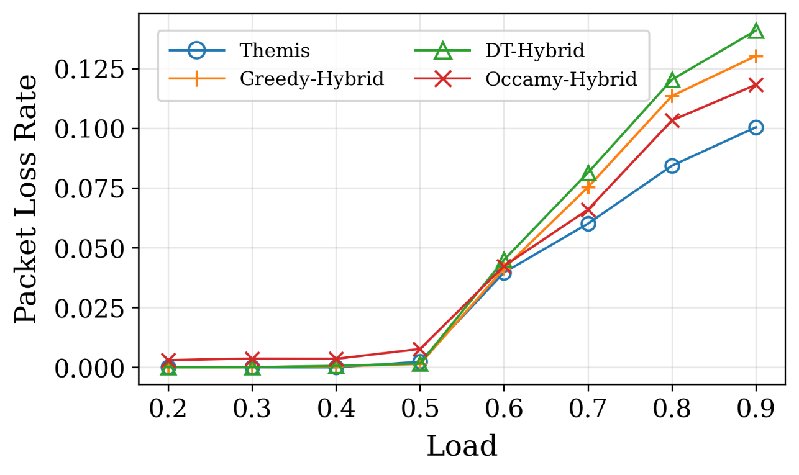
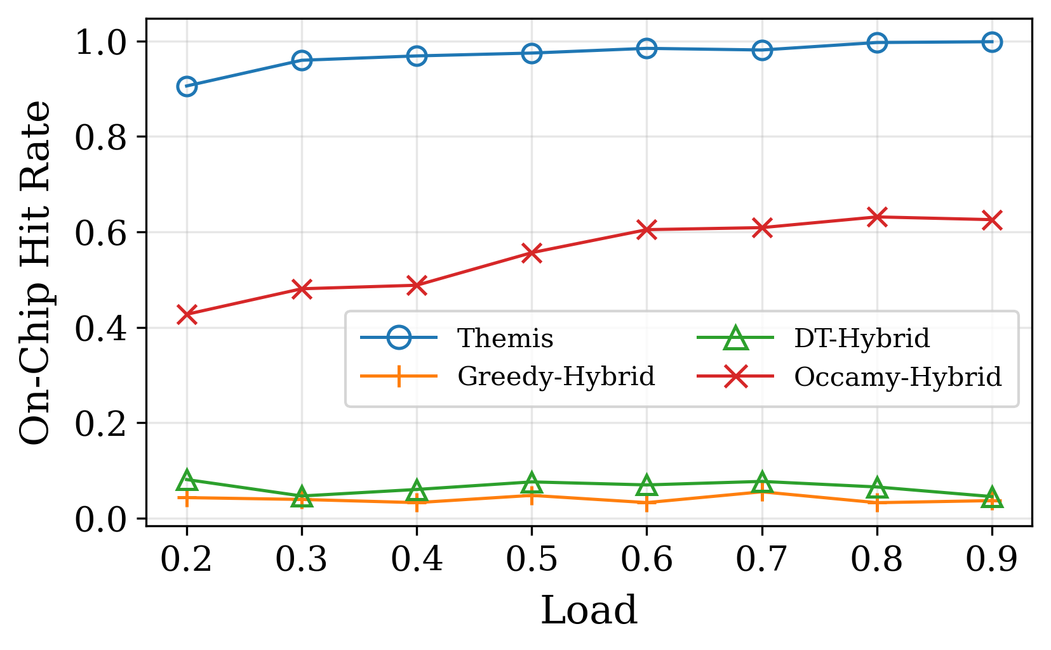
Performance of Themis
Packet loss rate
On-Chip Dequeue Hit Rate
Higher HBM throughput lets Themis absorb larger bursts — fewer drops;
Rank-based admission keeps soon-to-depart packets on-chip — higher hit rate
62

Slide 63







Summary: Networks Are Evolving into AI-Native Infrastructure
The Role of Traditional Networks
The Role of Networks in the AI Era
Fundamental Shift
Goal:
Connect & Forward
Goal:
Serving AI Training / Inference / Agent Workloads
Target:
General Traffic
Target:
Periodic, Bursty AI Traffic Sensitive to Bandwidth
Method:
Passive Support for Service Demands
Method:
Traffic-Aware Adaptive Optimization
Traffic Isolation
Traffic Scheduling
Traffic Prediction/
Engineering
NetJIT [SIGMETRICS'25]
HalfLife (EuroSys’24]
InfiniFlow [SIGCOMM’26]
Themis [NSDI'26]
BMW-Tree [SIGCOMM'23] /
vPIFO [SIGCOMM'24] /
Scale-up PIFO [SIGCOMM'26]
Empowering Future-Ready Adaptive Networks
63

